Slide 1
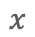

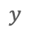
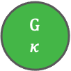
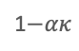
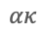


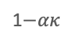

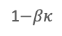
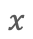

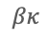
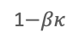

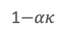

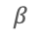
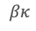

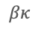
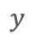
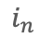
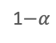
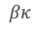

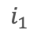

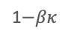
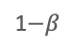
Fig 1
Environmental model
A
Two-state model
B
Multi-state model
G
G
$$1$$
$$ακ$$
G
$$2$$
$$ακ$$
$$ακ$$
G
$$κ$$
1$−α$
1$−ακ$
. . .
1$−ακ$
1$−ακ$
$$β$$
$$α$$
$$βκ$$
$$ακ$$
B
B
$$κ$$
$$βκ$$
B
$$βκ$$
$$βκ$$
B
$$1$$
1$−β$
1$−βκ$
$$κ−1$$
. . .
1$−βκ$
1$−βκ$
Dormancy model
C
Two-state model
D
Multi-state model
I₁
. . .
I_{n}
$$i_{1}$$
$$x$$
$$x$$
$$d$$
$$d$$
$$i_{n}$$
A
$$d$$
D
A
$$d$$
D
$$r$$
∅
$$r$$
∅
$$y$$
$$y$$
Good environment
Bad environment

Slide 2
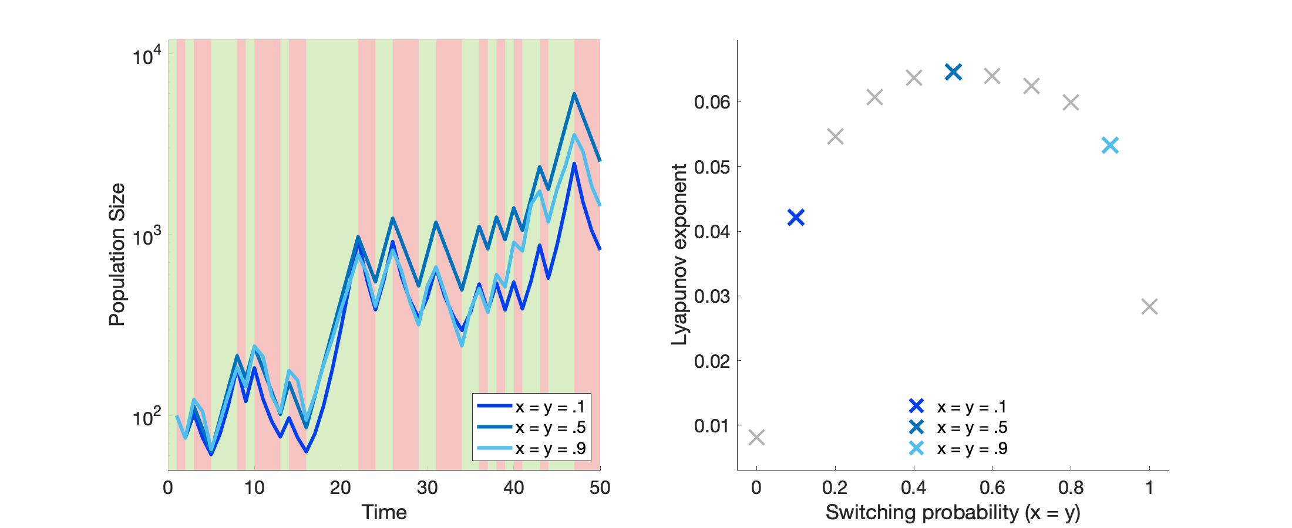
Fig 2
A
Good environment
Bad environment
B
G
G
G
G
G
G
G
G
G
G
G
G
G
B
B
B
B
B
B
B
B
B
B
B
B
B

Slide 3
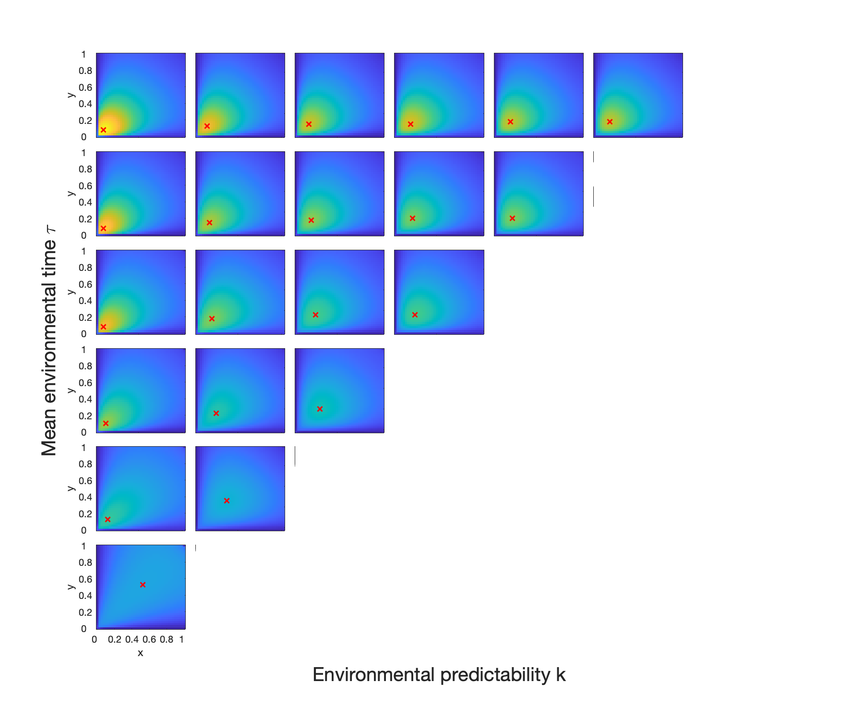

1
2
3
4
5
6
Fig 3
7
6
5
4
3
2

Slide 4
Fig 5
A
B

Slide 5
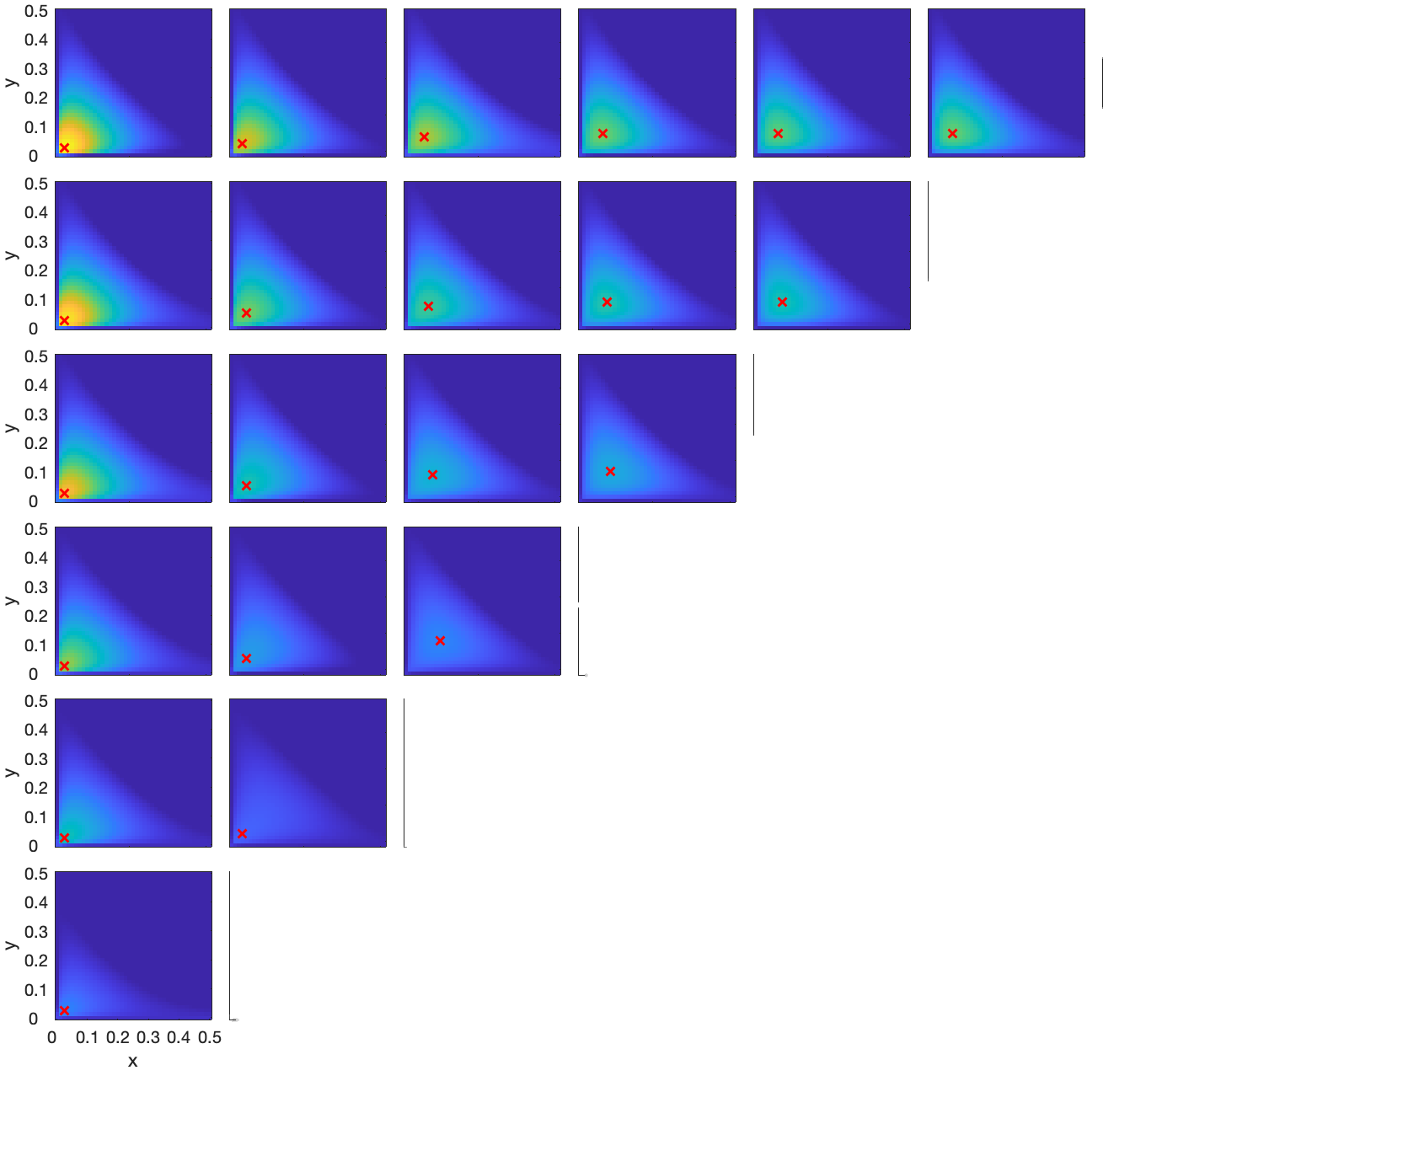
1
2
3
4
5
6
Fig 4
7
6
5
4
3
2

Slide 6
Fig 6
A
B

Slide 7
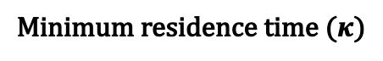
Fig 7
Minimum residence time ($κ$)
A
B
C
D

